Slide 1
S3 Work Experience Week
Assembly
8 January 2019

Slide 2
S3 Careers Input
Routes to Employment Block in Learner Journey – Sept/Oct
World of Work Evening in November – WoW18
Careers Interviews – January 2019
Choices for S4 – from January 2019
Work Experience Week - May 2019

Slide 3
Some Statistics

Slide 4
Future Growth Sectors

Slide 5
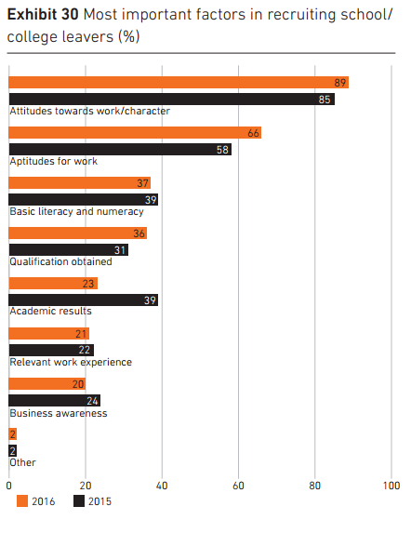
What are employers looking for?
“Businesses are clear that first and foremost they want to recruit young people with attitudes and attributes such as resilience, enthusiasm and creativity. They are
not selecting simply on the basis of academic ability.”
“Less than one business in five(19%) prefers just academic qualifications “
The right combination, CBI (2016)

Slide 7
Aspects of Work-Based Learning
Inspiration
This includes careers events, employer-led research tasks, employer presentations and site visits.
Simulation
This includes simulated work environments in school and at college for those attending BCSA courses. Also includes enterprise activities and mock interviews.
Placement

Slide 8
Work Placement
Timetabled opportunities to undertake work placements at an agreed time each week within the school week (S5/6)
An introductory week-long experience to the workplace followed by additional opportunities (S3)
Placements undertaken out-with the school day (during term holidays e.g. internship model)
Voluntary/Social Enterprise experience
Placements as part of a school-college course – eg Foundation Apprenticeships in S6
Internships for university and college students
Part-time work also counts as work experience

Slide 9
Top five reasons why work experience is important
(from MWOW website)
Decisions
You’ll get a taste of what a job or workplace is like, so you can figure out if you’re interested in that kind of career.
Self-confidence
Working with other people and doing your tasks well helps you build your confidence
It looks good
On your CV, UCAS form, or college application. Work experience shows you’re enthusiastic and ready to work hard. You can pick out particular achievements to show off
New skills
Working with other people helps you build the skills employers love to see on your CV
Networking
You’ll meet people at work and might attend meetings or events. You’ll make contacts that could provide a reference or help you in the future.

Slide 10
Transferable and sustainable employability skills
Managing time
Planning and organising
Communication – both oral and written
Solving problems
Using ICT
Working with others
Thinking critically and creatively

Slide 11
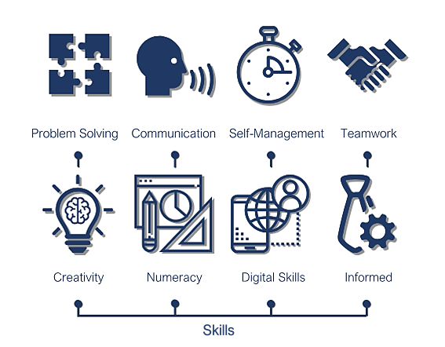
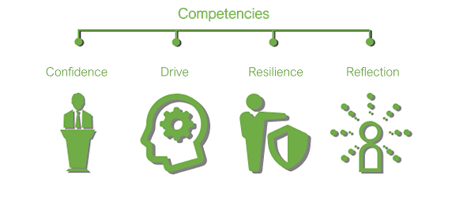

Slide 14
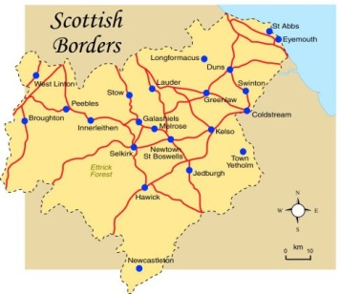
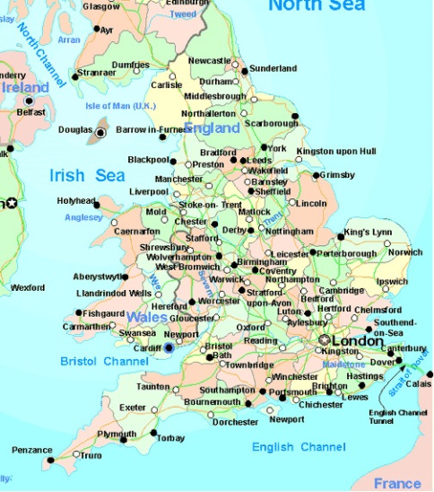
USUALLY
Working with family
or at EHS
PREFERABLY NOT …
FOR THE SUPER-ADVENTUROUS!!
A FEW
VERY RARELY

Slide 15
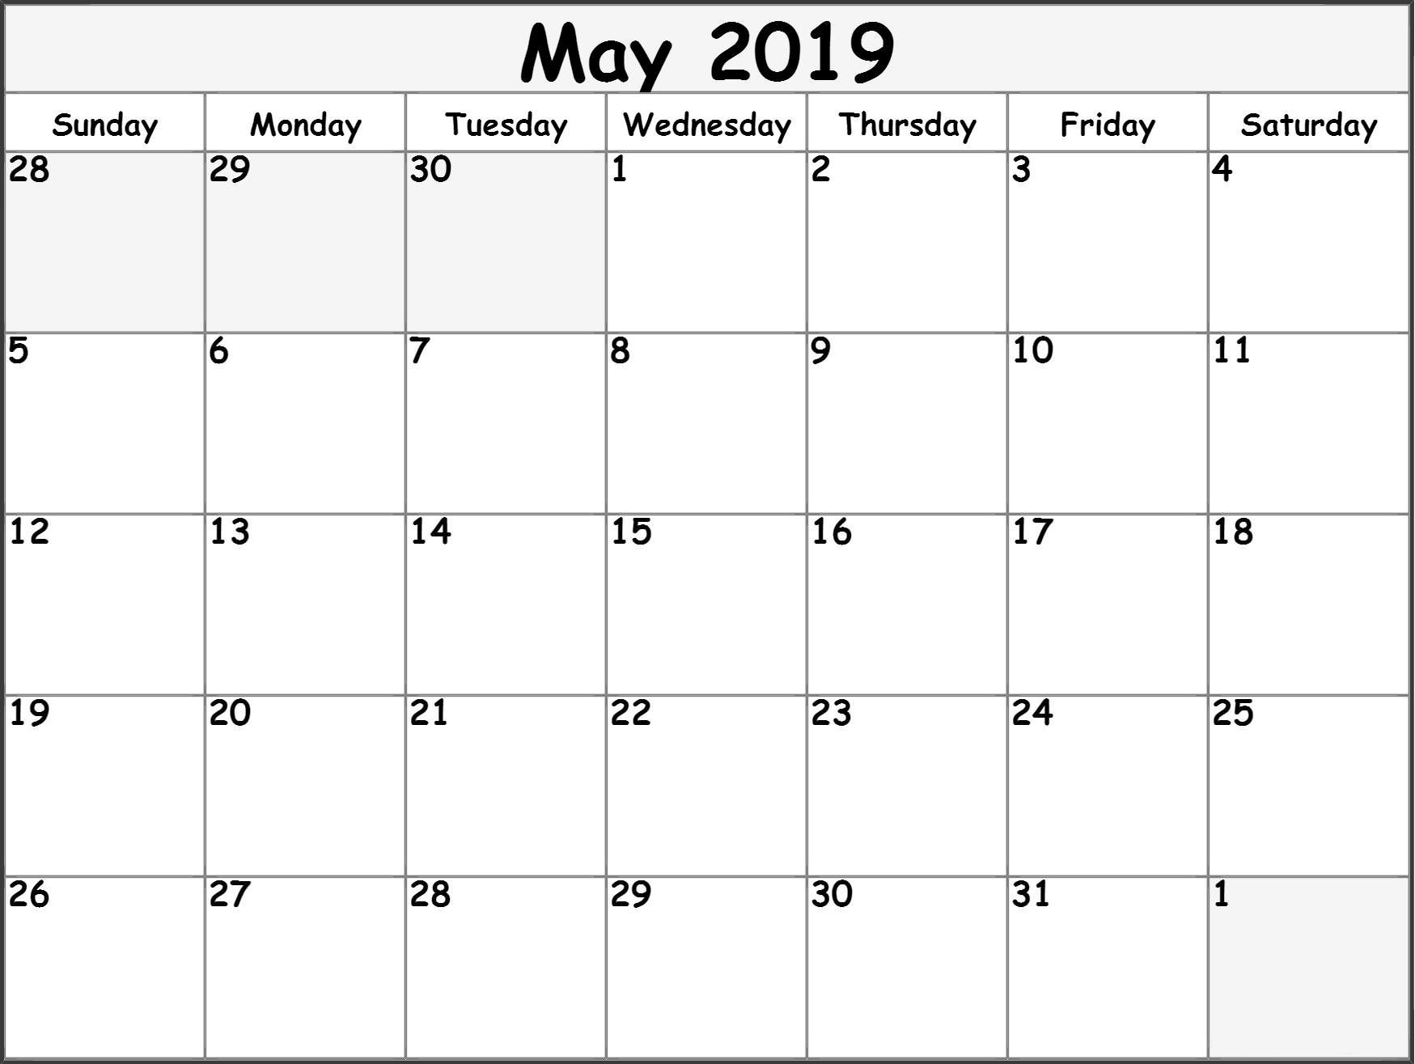
Usually a 5-day placement
7 – 10 May 2019

Slide 17
Take home letter (with flowchart) and green application form
Discuss at home and take time to consider options
Make contact with employers and get agreement about placement
Return form by 22nd February to the school office/postbox
Help office and guidance staff as required
Work will take place in Learner Journey classes from March
SPEAK TO MR FERGUSON AT ANY TIME IF NEEDED

Slide 20
This example highlights the benefits of work experience – when you show initiative and take responsibility for organising it!

Slide 21
Full article on MWOW site
Develop your skills
‘What we try to do is help young people develop their skills for work,’
‘All the way through, we’re asking them what skills they’ve learned, and keeping track of how they’ve developed.
‘When you’re applying for jobs, you can look back on what you’ve done and in your placement and see clearly that you’ve got something to offer employers.'
Learn about the company
'Use work experience as an opportunity to learn about the company, and explore all of the roles in it. Think about what might suit you in the future. Ask lots of questions – find out what the jobs involve.
‘There were things in the company that they hadn’t even considered. Through the placement, they know more about what’s actually on offer at Johnstons.
Use your experience to get a job
‘Some of the pupils who went through the programme last year have now gone on to work for us,’ ‘If you’re applying for a job in the same place you did your work experience, you’ll be in a good position.

Slide 22
Advice
Ask lots of questions. Talk to people about their jobs and how they got them, and ask about the company. Ask about the industry and what advice they have for getting in
Keep a note of any work you do, and the skills and strengths you used to do it. This will come in handy when you update your CV to include your experience. It’s also a good reminder for application forms and interviews in the future
Ask for feedback at the end of your placement. Find out how you did, and what their impressions of you were
Get a reference. Ask if you can add them as a referee on your CV
Say thanks. Pop your supervisor a quick email or thank-you card to say you appreciated the opportunity and ask that they keep you in mind for future jobs

Slide 23
Recognition/Celebration #1
Work Experience Award 2018
Eden – Kieron Butler – Newtown Primary School
Leader – Sam Borg – IQX Limited
Teviot – Elsbeth Roper – Straub Medical
Turfford – Lauren Sutton – Aitken Turnbull Architects
Tweed - Ellie Makel – Radio Borders

Slide 24
Recognition/Celebration #2 newsletter local press social media …

Slide 25
Recognition/Celebration #3
Work Placement Unit
SQA Work Placement units are designed to recognise the valuable learning and development that takes place as a result of participating in a work placement.
Candidates will review career aspiration(s) and abilities as part of the unit. They will also review their own progress and learning gained in the workplace.
Last session, 103 students were successful in attaining this ward with 55 being noted as ‘highly commendable’

